Slide 1
JavaScript Event Handling

Slide 2
Outline
Introduction
Reviewing the load Event
Event mousemove and the event Object
Rollovers with mouseover and mouseout
Form Processing with focus and blur
More Form Processing with submit and reset
Event Bubbling

Slide 3
Introduction
We’ve seen that HTML5 pages can be controlled via scripting, and we’ve already used several events—load, submit and click—to trigger calls to JavaScript functions.
This chapter takes a deeper look into JavaScript events, which allow scripts to respond to user interactions and modify the page accordingly.
Events allow scripts to respond to a user who is moving the mouse, entering form data, pressing keys and much more.
Events and event handling help make web applications more dynamic and interactive.

Slide 4
Reviewing the load Event
In several earlier examples, we used the window object’s load event to begin executing scripts.
This event fires when the window finishes loading successfully (i.e., all its children are loaded and all external files referenced by the page are loaded).
Actually, every DOM element has a load event, but it’s most commonly used on the window object.

Slide 5
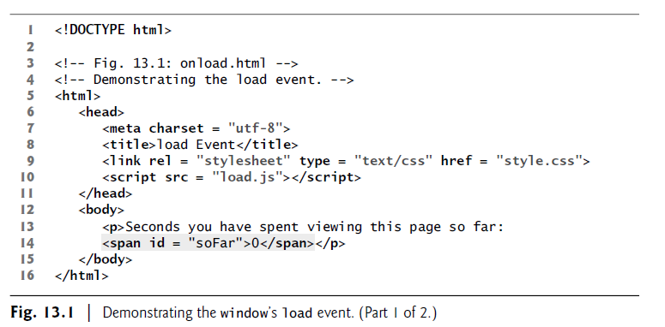

Slide 6
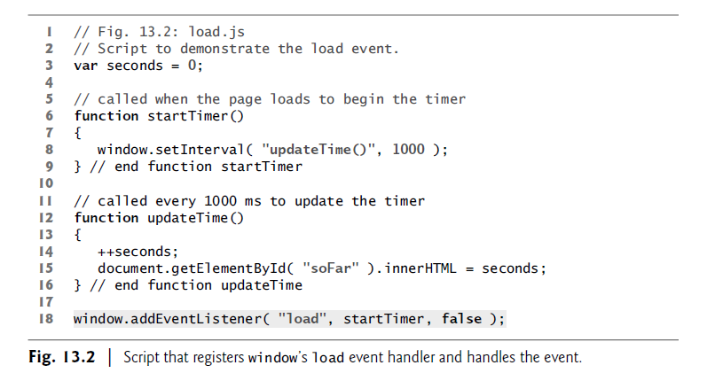

Slide 7
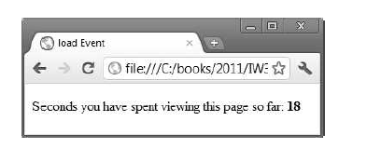
Registering an Event Handler
An event handler is a function that responds to an event.
Assigning an event handler to an event for a DOM node is called registering an event handler.
The script registers the window’s load event handler at line 18.
Method addEventListener is available for every DOM node.
The method takes three arguments:
• The first is the name of the event for which we’re registering a handler.
• The second is the function that will be called to handle the event.
• The last argument is typically false—the true value is beyond this book’s scope.

Slide 8
Registering Multiple Event Handlers
Method addEventListener can be called multiple times on a DOM node to register more than one event-handling method for an event.
For example, if you wanted to perform a visual effect when the mouse is over a button and perform a task when that button is pressed, you could register mouseover and click event handlers.
Removing Event Listeners
It’s also possible to remove an event listener by calling removeEventListener with the same arguments that you passed to addEventListener to register the event handler.

Slide 9
A Note About Older Event-Registration Models
The inline model places calls to JavaScript functions directly in HTML code.
For example, the following code indicates that JavaScript function start should be called when the body element loads:
<body onload=“start()”>
The onload attribute corresponds to the body element’s load event.
By current web development standards, it’s generally considered poor practice to intermix HTML and JavaScript code in this manner.

Slide 10
The traditional model uses a property of an object to specify an event handler.
For example, the following JavaScript code indicates that function start should be called when document loads:
document.onload = “start()”;

Slide 11
Event mousemove and the event object
This section introduces the mousemove event, which occurs whenever the user moves the mouse over the web page.
We also discuss the event object, which contains information about the event that occurred.
The example in Figs. 13.3–13.5 creates a simple drawing program that allows the user to draw inside a table element in red or blue by holding down the Shift key or Ctrl key and moving the mouse over the box.

Slide 12
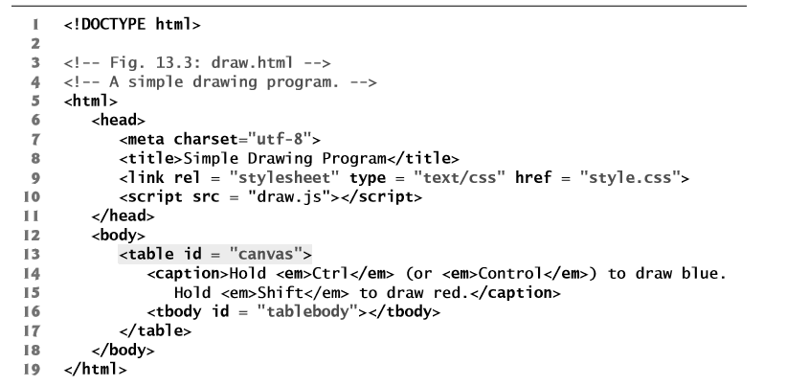

Slide 13
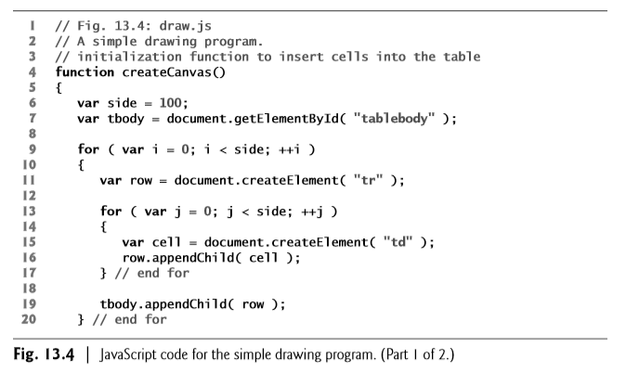

Slide 14
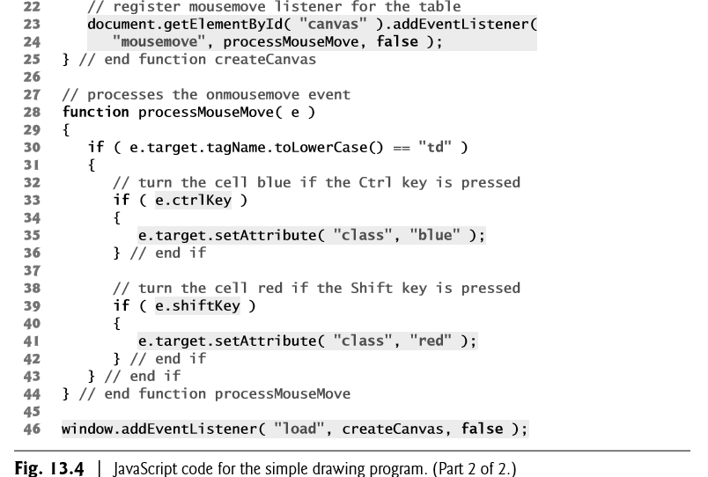

Slide 15
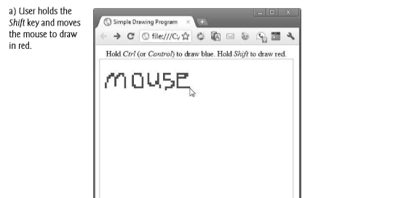
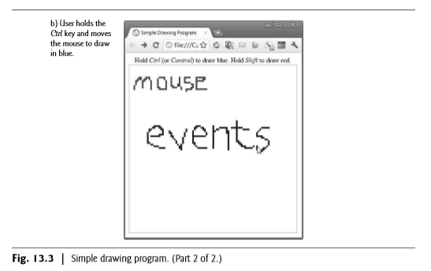

Slide 16
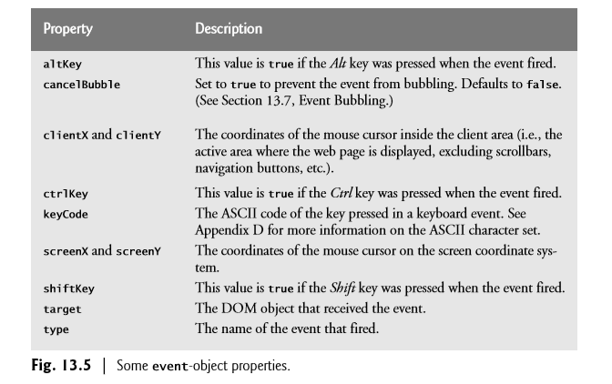
Event object properties

Slide 17
Rollovers with mouseover and mouseout
Two more events fired by mouse movements are mouseover and mouseout.
When the mouse cursor moves into an element, a mouseover event occurs for that element.
When the cursor leaves the element, a mouseout event occurs.
The example in Figs. 13.6–13.7 uses these events to achieve a rollover effect that updates text when the mouse cursor moves over it.
We also introduce a technique for creating rollover images.

Slide 18
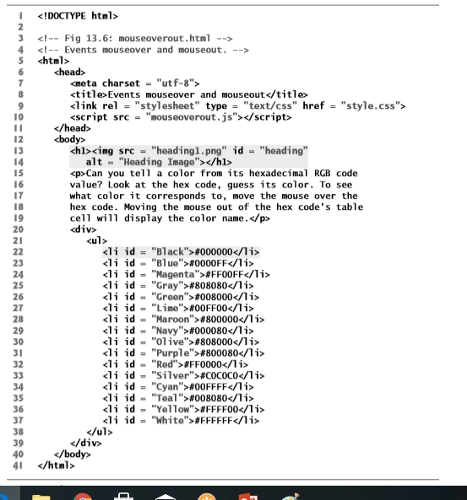

Slide 19
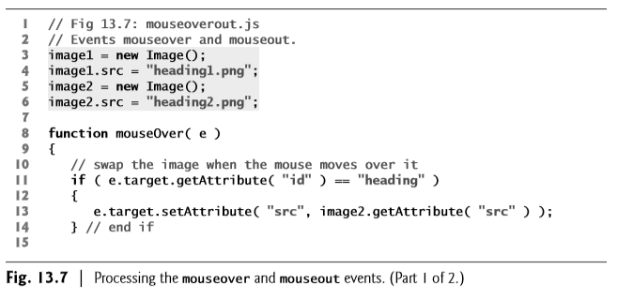

Slide 20
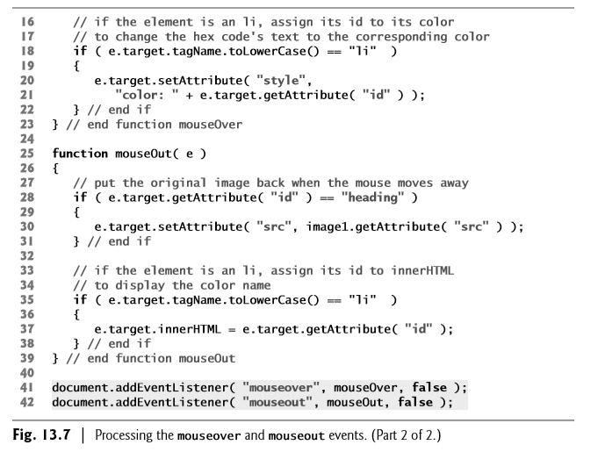

Slide 21
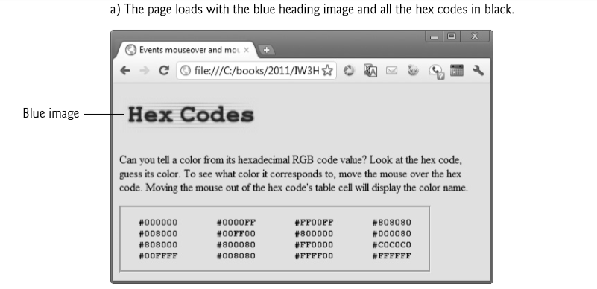

Slide 22
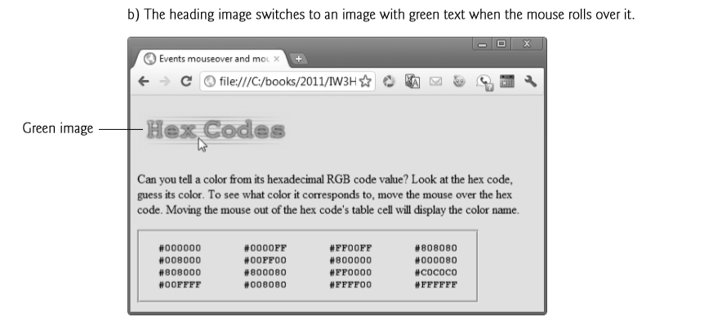

Slide 23
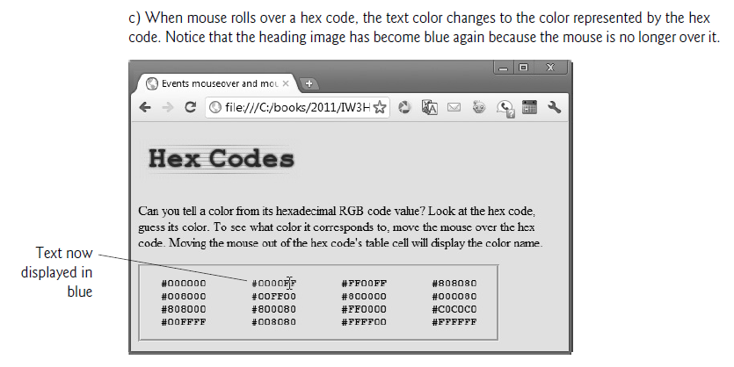

Slide 24
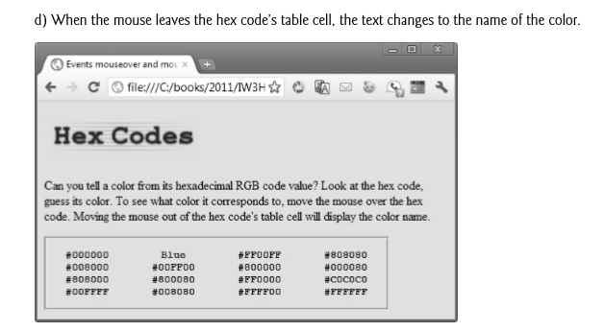

Slide 25
Form Processing with focus and blur
The focus and blur events can be useful when dealing with form elements that allow user input.
The focus event fires when an element gains the focus (i.e., when the user clicks a form field or uses the Tab key to move between form elements), and
The blur event fires when an element loses the focus, which occurs when another control gains the focus.

Slide 26
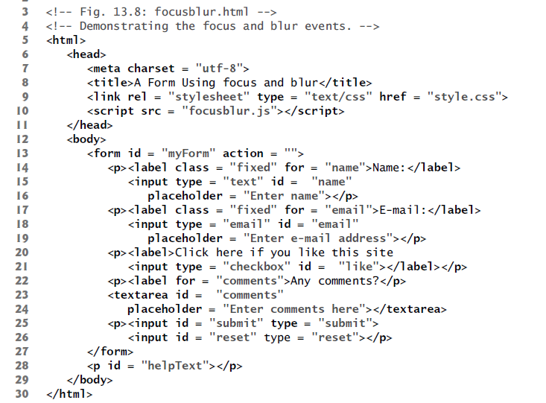

Slide 27
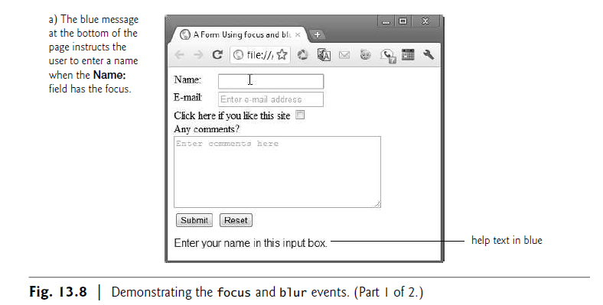

Slide 28
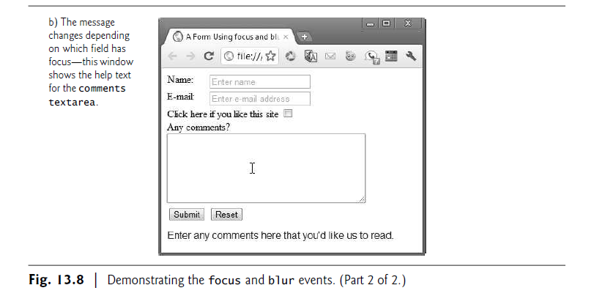

Slide 29
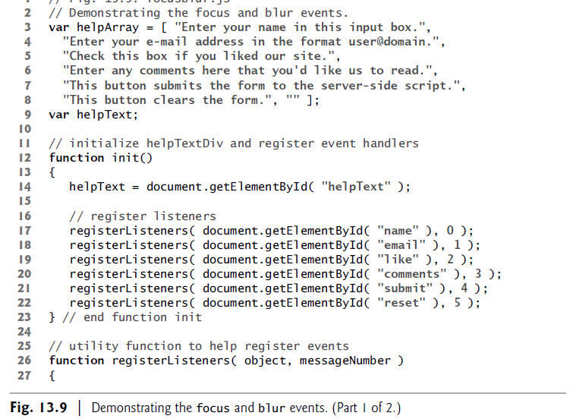

Slide 30
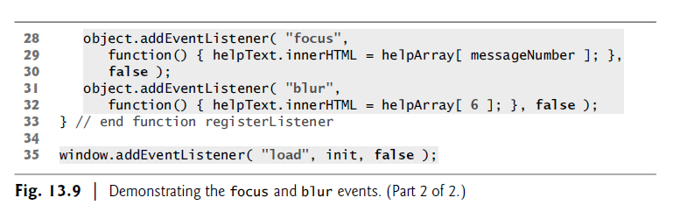

Slide 31
Event Bubbling
Event bubbling is the process by which events fired on child elements “bubble” up to their parent elements.
When an event is fired on an element, it’s first delivered to the element’s event handler (if any), then to the parent element’s event handler (if any).
This might result in event handling that was not intended.
If you intend to handle an event in a child element alone, you should cancel the bubbling of the event in the child element’s event-handling code by using the cancelBubble property of the event object.

Slide 32
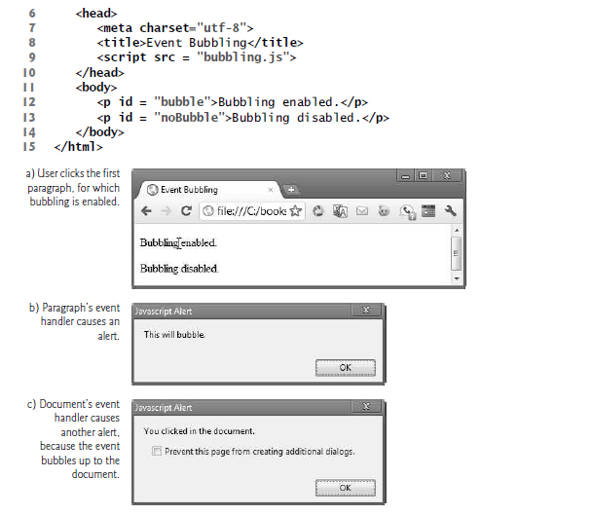

Slide 33
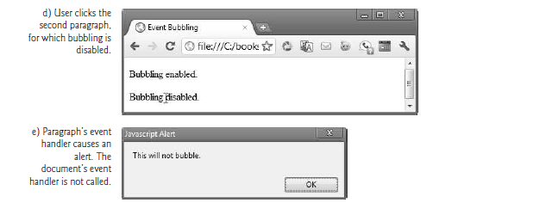

Slide 34
